Slide 1
WISCONSIN DEPARTMENT OF NATURAL RESOURCES
POWTS OVERVIEW
Monica Begley & Laura Rodriguez Alvarez
Water Quality Program

Slide 2
Outline
What is Regulated by the DNR?
How to Determine Cumulative Design Flow Rate
What is Considered Domestic Wastewater?
What is Considered Industrial Wastewater?
Plan Review Requirements
WPDES Permitting Requirements
MOU Update
WISCONSIN DEPARTMENT OF NATURAL RESOURCES | DNR.WI.GOV

Slide 3
What Is Regulated By The DNR?
Private Onsite Wastewater Treatment Systems that:
Have a design flow rate of greater than or equal to 12,000 gallons per day
Are new residential dwellings with greater than or equal to 85 bedrooms
Treat a mix of domestic and industrial wastewater at any flow rate
Treat industrial wastewater at any flow rate
WISCONSIN DEPARTMENT OF NATURAL RESOURCES | DNR.WI.GOV

Slide 4
Cumulative Design Flow Rate
NR 200.03(5) states that : if one private sewage system is located near another private sewage system, the design capacities of each of the systems shall be added together if the perimeter of the distribution cell of one system is less than 1,500 feet from the perimeter of a distribution cell of another system and the systems are under the same ownership.
WISCONSIN DEPARTMENT OF NATURAL RESOURCES | DNR.WI.GOV

Slide 5
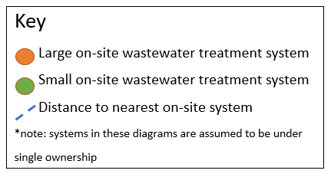
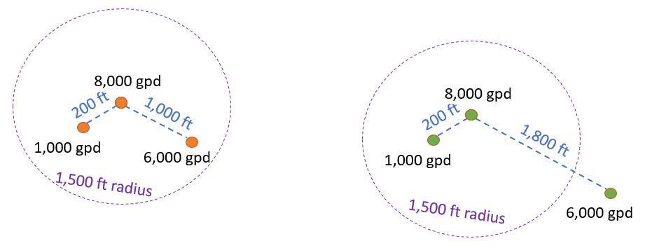
Examples
WISCONSIN DEPARTMENT OF NATURAL RESOURCES | DNR.WI.GOV

Slide 6
What Is Considered Domestic Wastewater?
Wastewater typically discharged from plumbing facilities in private dwellings or commercial domestic establishments which includes (s. NR 205.03(14), Wis. Adm. Code). :
sanitary, bath, laundry, dishwashing, garbage disposal and cleaning wastewaters.
For reference, commercial domestic establishment means any establishment which has the capability to collect, treat or dispose of domestic wastes including but not limited to restaurants, country clubs, mobile home parks, motels and hotels (s. NR 205.03(7), Wis. Adm. Code) .
WISCONSIN DEPARTMENT OF NATURAL RESOURCES | DNR.WI.GOV

Slide 7
*Note*
If the wastewater is above DSPS limit concentrations for domestic wastewater (BOD, TSS, etc), that is considered high strength waste and needs to be pretreated. That does not necessarily make the wastewater industrial strength and it therefore does not need DNR concurrence if less than 12,000 gallons per day.
WISCONSIN DEPARTMENT OF NATURAL RESOURCES | DNR.WI.GOV

Slide 8
What Is Considered Industrial Wastewater?
Process wastewater and waste liquid products, including:
Silage leachate, whey, whey permeate, whey filtrate, contact cooling water, cooling or boiler water containing water treatment additives, and wash water generated in industrial, commercial and agricultural operations which result in a point source discharge to a land treatment system (s. NR 214.02(27), Wis. Adm. Code).
WISCONSIN DEPARTMENT OF NATURAL RESOURCES | DNR.WI.GOV

Slide 9
*Note*
NR 214.16 states that subsurface absorption systems may not be used to treat commercial laundry, laundromat, motor vehicle cleaning and motor vehicle maintenance wastewaters unless the owner or operator can demonstrate and the department determines that specific factors exist which will allow the wastewater to be adequately treated in a subsurface absorption system.
If industrial or mixed wastewater is not acceptable for disposal through a typical subsurface system or through application to the land surface then the industrial or mixed wastewater may be collected in a holding tank and hauled to a municipal wastewater treatment facility for disposal.
WISCONSIN DEPARTMENT OF NATURAL RESOURCES | DNR.WI.GOV

Slide 10
Plan Review
Requirements
WISCONSIN DEPARTMENT OF NATURAL RESOURCES | DNR.WI.GOV

Slide 11
What Should a Submittal Have (domestic only)?
Facility Ownership and Management
Site Information
Location and Design of Infiltration System
Treatment System Design
Demonstration of nitrogen compliance with NR 140 groundwater standards
Demonstration of BOD and fecal coliform compliance with NR 140 groundwater standards
Demonstration of Chloride compliance with NR 140 groundwater standards
Conformance with Area-Wide Water Quality Management Plan (if applicable)
Environmental Assessment
*Make vertical distance to bedrock and distance to nearest well explicit in drawings and narrative.*
WISCONSIN DEPARTMENT OF NATURAL RESOURCES | DNR.WI.GOV

Slide 12
What Should a Submittal Have (mixed/industrial)?
Contact information of the owner and treatment system designer.
Address or legal description of the treatment system location.
General description of the overall site (if available, include a photocopy of a map showing the general project location and a site plan sketch or drawing showing pertinent features); indicate the approximate available horizontal setback distances of the treatment/subsurface discharge system from nearby buildings, property boundaries, water supply wells and any nearby resource features such as wetlands, floodplains, surface waters, etc.
Description of the type of activities that will produce the mixed wastewater, the general nature/characteristics of the contributing wastewater streams and approximate design flow rates.
Description of the treatment system and subsurface discharge system along with any proposed supplemental preliminary treatment units.
Description of any solid residuals generated by the industrial wastewater flow sources and how these materials will be collected/disposed.
*Make vertical distance to bedrock and distance to nearest well explicit in drawings and narrative.*
WISCONSIN DEPARTMENT OF NATURAL RESOURCES | DNR.WI.GOV

Slide 13
What Does DNR Assess?
The nature and source of the industrial wastewater component, potential for impacts on the treatment system and groundwater quality
Recommend any supplemental preliminary treatment steps deemed necessary.
If it is determined that the industrial wastewater within the resulting mixed wastewater will have characteristics similar to and no stronger than domestic wastewater, or the proposal presents minimal groundwater quality concerns, the DNR will issue a "concurrence" letter
If it is determined that the industrial wastewater is not similar to domestic wastewater, coverage under a WPDES wastewater discharge permit may be required.
WISCONSIN DEPARTMENT OF NATURAL RESOURCES | DNR.WI.GOV

Slide 14
Who Can Submit This?
The designer would need to have a WI License Number. Typically an engineer, soil scientist or plumber.
WISCONSIN DEPARTMENT OF NATURAL RESOURCES | DNR.WI.GOV

Slide 15
Where Are Submittals Sent?
Submittals may be made electronically only or on paper and electronically. Electronic submittals less than 20MB may be made to DNRMixedPOWTSReview@wisconsin.gov for industrial/mixed POWTS and to Jason.Knutson@wisconsin.gov for domestic POWTS.
Mailed submittals may be made to:
Jason Knutson Wastewater Section Chief Wisconsin DNR - WY/3 101 S Webster St PO Box 7921 Madison, WI 53707-7921 FAX: 608-267-2800
WISCONSIN DEPARTMENT OF NATURAL RESOURCES | DNR.WI.GOV

Slide 16
WPDES Permitting Requirements
WISCONSIN DEPARTMENT OF NATURAL RESOURCES | DNR.WI.GOV

Slide 17
WPDES Permitting for All POWTS
General Permits
Domestic Wastewater to a Subsurface Soil Absorption System (WI-0062901-3)
Industrial Liquid Waste to a Subsurface Soil Absorption System (WI-0055611-7)
How to apply
Verify eligibility with questionnaire
If you’re ineligible, an individual permit must be acquired
Submit an Electronic Notice of Intent (eNOI) 30 days before expected discharge commences
Submit a management plan with the eNOI
Wastewater General Permits | | Wisconsin DNR
Notes:
The management plan shall specify information on pretreatment processes, monitoring procedures, operational procedures, best management and waste reduction practices, and any other pertinent information.

Slide 18
General Permit for Domestic Wastewater to a Subsurface Soil Absorption System Overview
Monitoring required quarterly for BOD, TDS, Nitrogen Organic Dissolved, Nitrogen Ammonia Dissolved, Chloride Dissolved
Daily flow rate monitoring
Any amendment to the management plan must be submitted 90 calendar days from the effective date of general permit.

Slide 19
General Permit for Industrial Liquid Waste to a Subsurface Soil Absorption System Overview
Monitoring required annually for pH, BOD, TSS, Nitrogen, Organic Dissolved, Nitrogen, Nitrite + Nitrate (as N) Dissolved, Nitrogen, Ammonia Dissolved, Chloride Dissolved, Oil and Grease (Hexane)
Daily flow rate monitoring
Any amendment to the management plan must be submitted 90 calendar days from the effective date of general permit.

Slide 20
MOU (Memorandum of Understanding) Update
1999 MOU between DComm (now DSPS) and DNR is being rewritten to clarify regulatory authority
MOU will be available for public comment after DSPS review

Slide 21
Laura Rodriguez Alvarez
Laura.RodriguezAlvarez@wisconsin.gov
Monica Begley
Monica.Begley@wisconsin.gov

